Slide 1
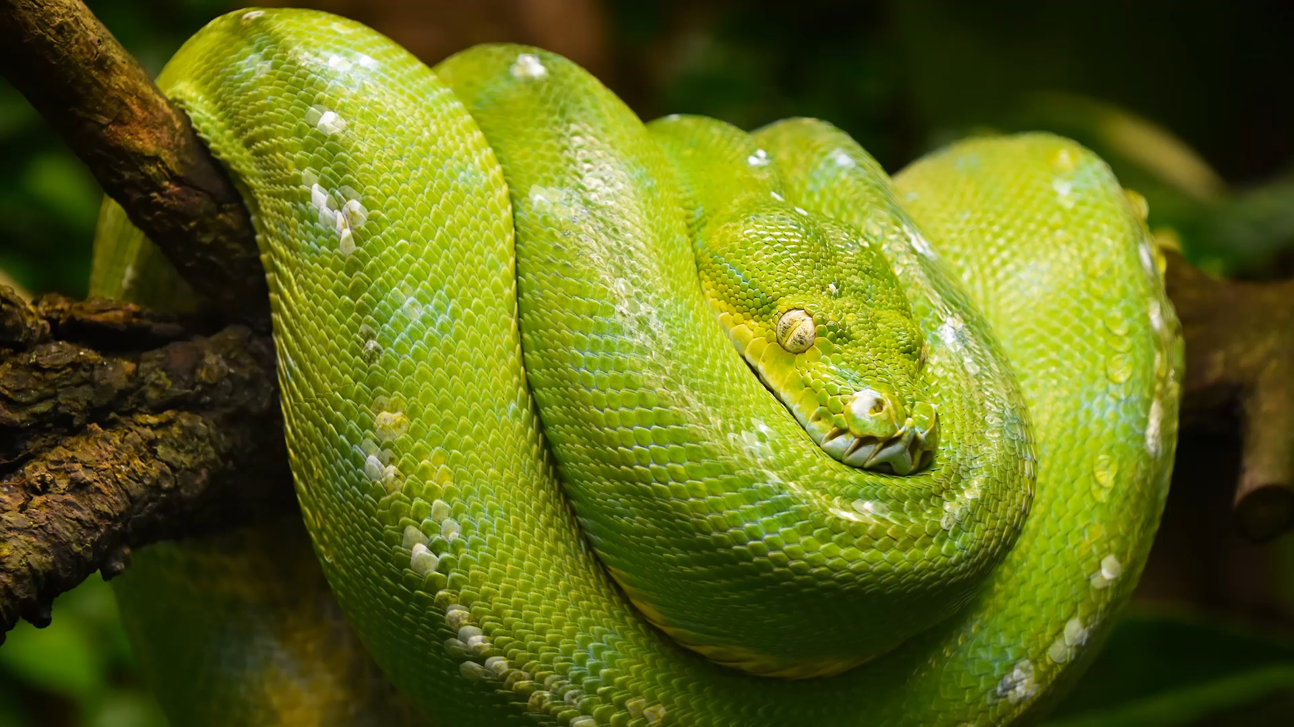
Python Sets

Slide 2
Set
Sets are used to store multiple items in a single variable.
Set is one of 4 built-in data types in Python used to store collections of data, the other 3 are List, Tuple, and Dictionary, all with different qualities and usage.
A set is a collection which is unordered, unchangeable*, unindexed, Unique

Slide 3
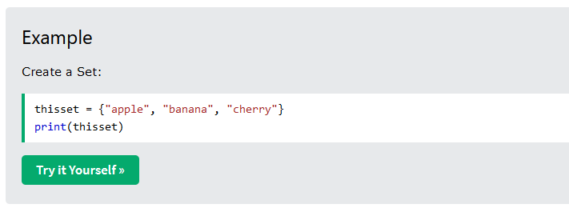
Example

Slide 4
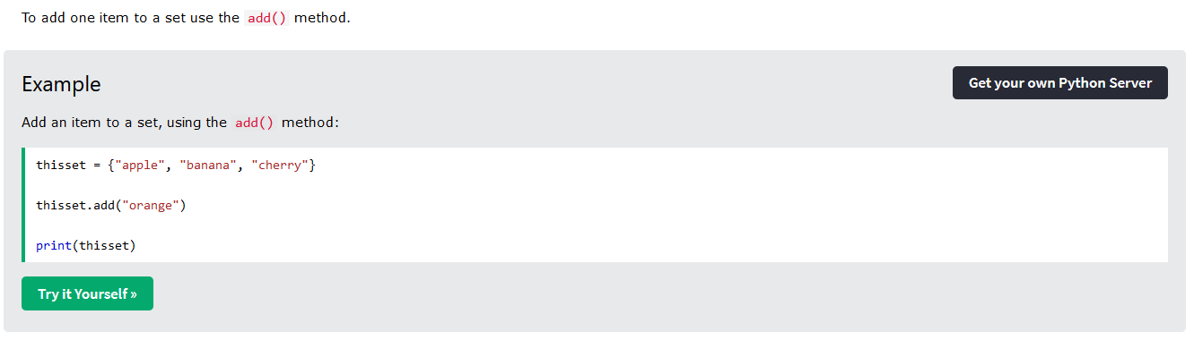
Add Items

Slide 5
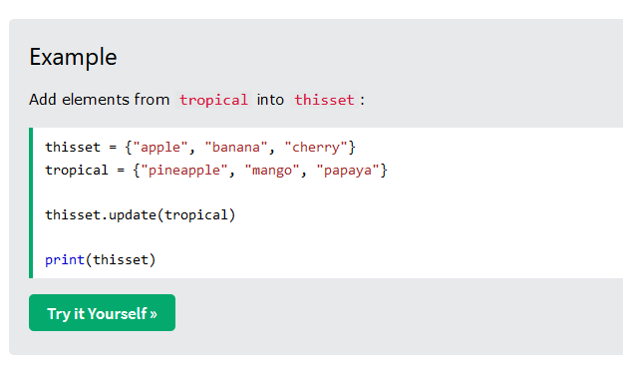
Merge Sets

Slide 6
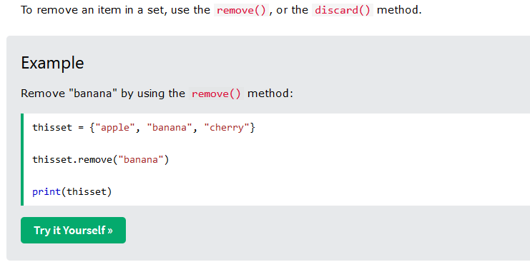
Remove Item

